Slide 1
Sanitation Assainissement Eau Potable (SAEP)

Slide 2
S.A.E.P
Accessibility of the platform

Slide 3
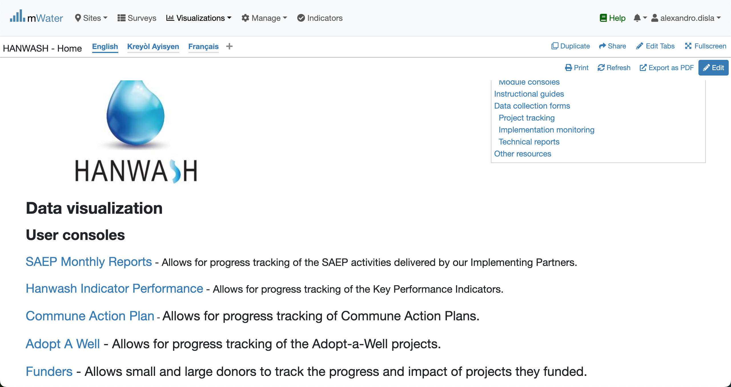
Hanwash HOME
URL LINK : http://go.mwater.co/hanwash

Slide 4
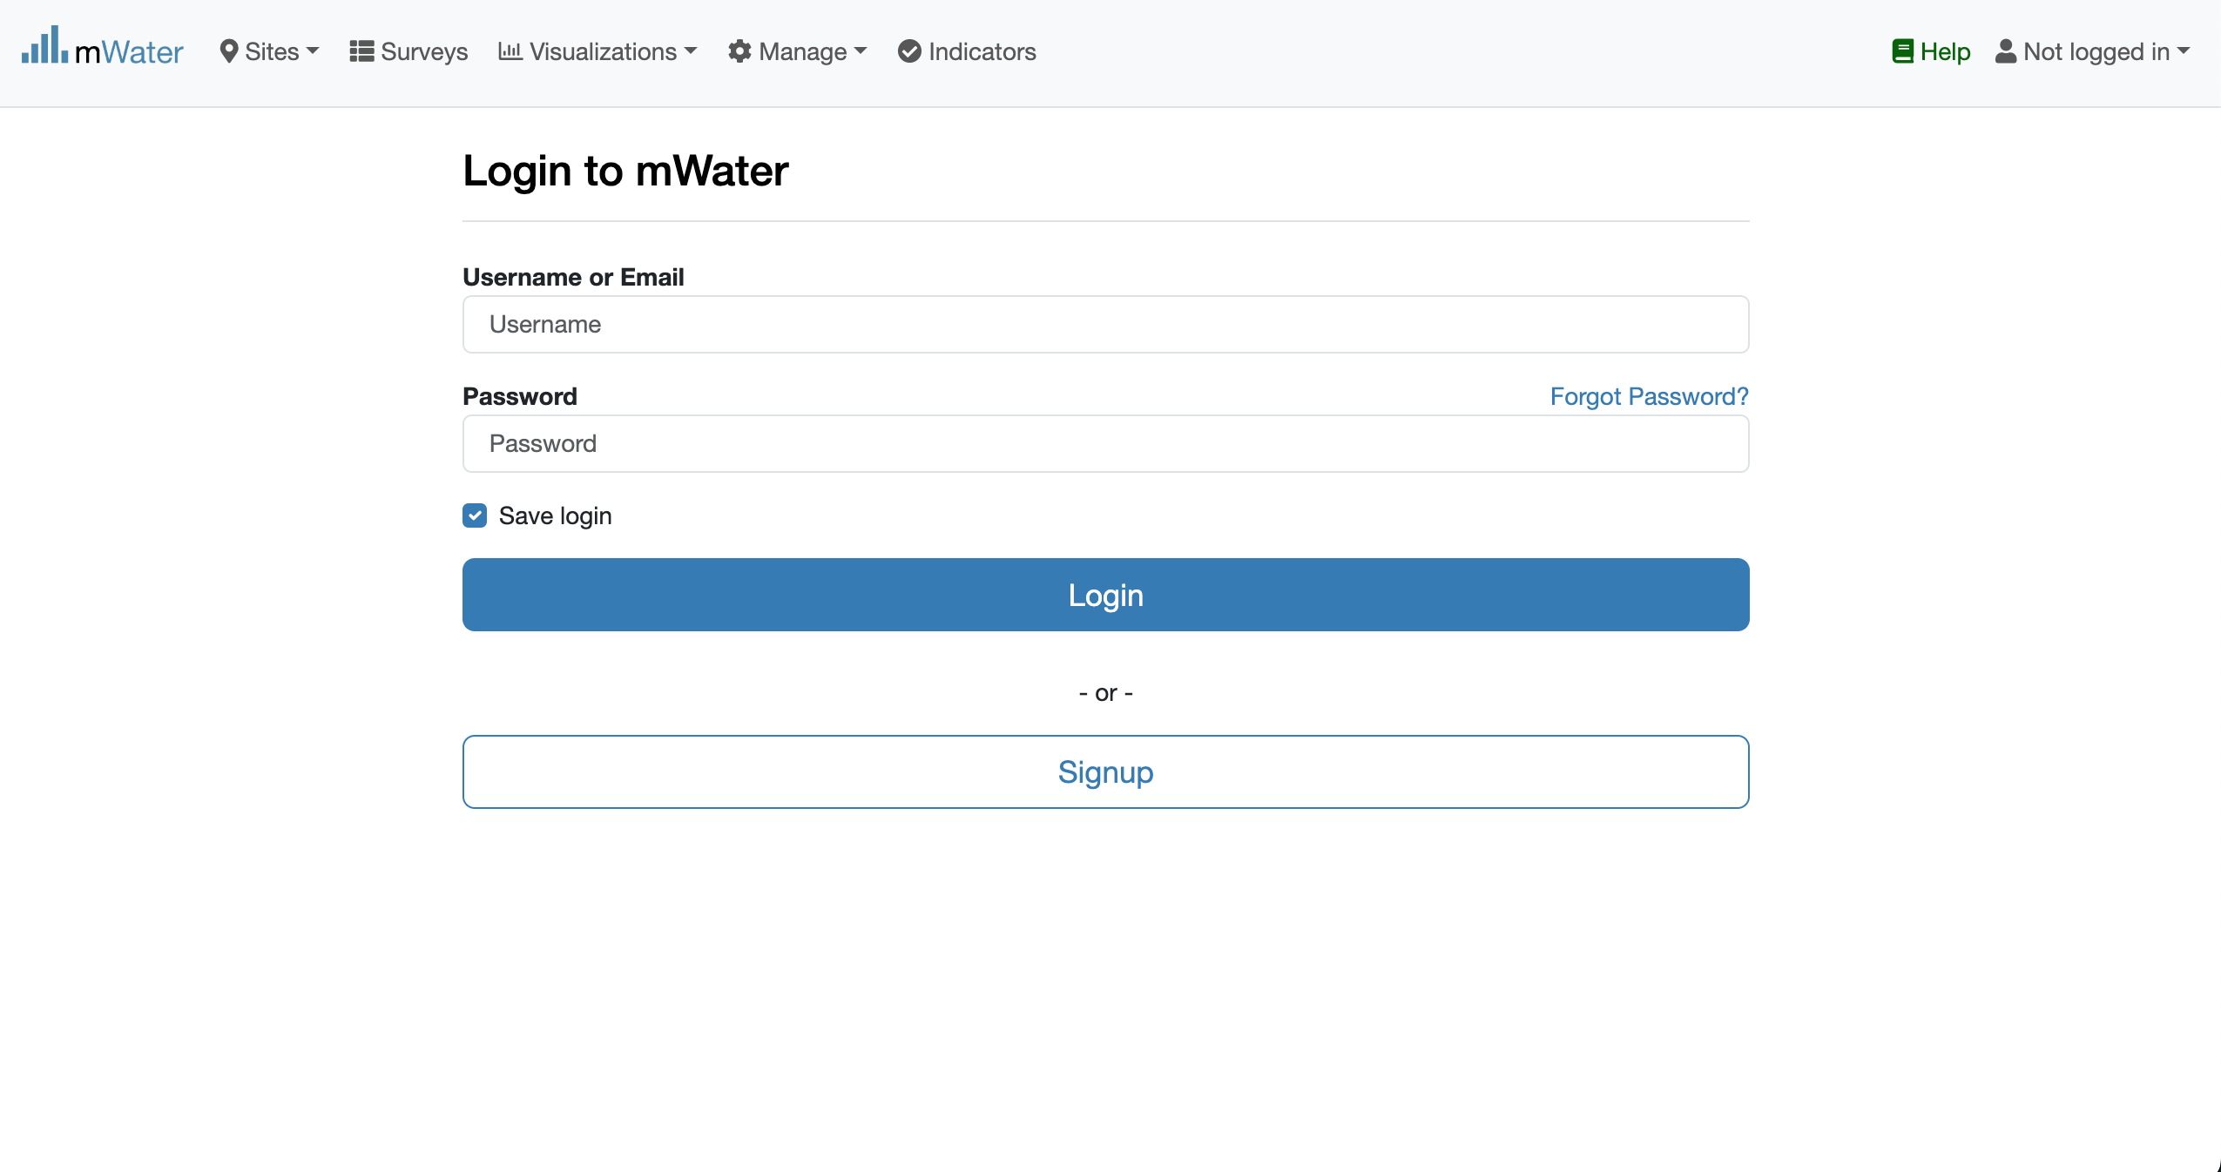
Access The SAEP & Login process
Click on the HIP url link
Log status indicator
Please enter your Credentials

Slide 5

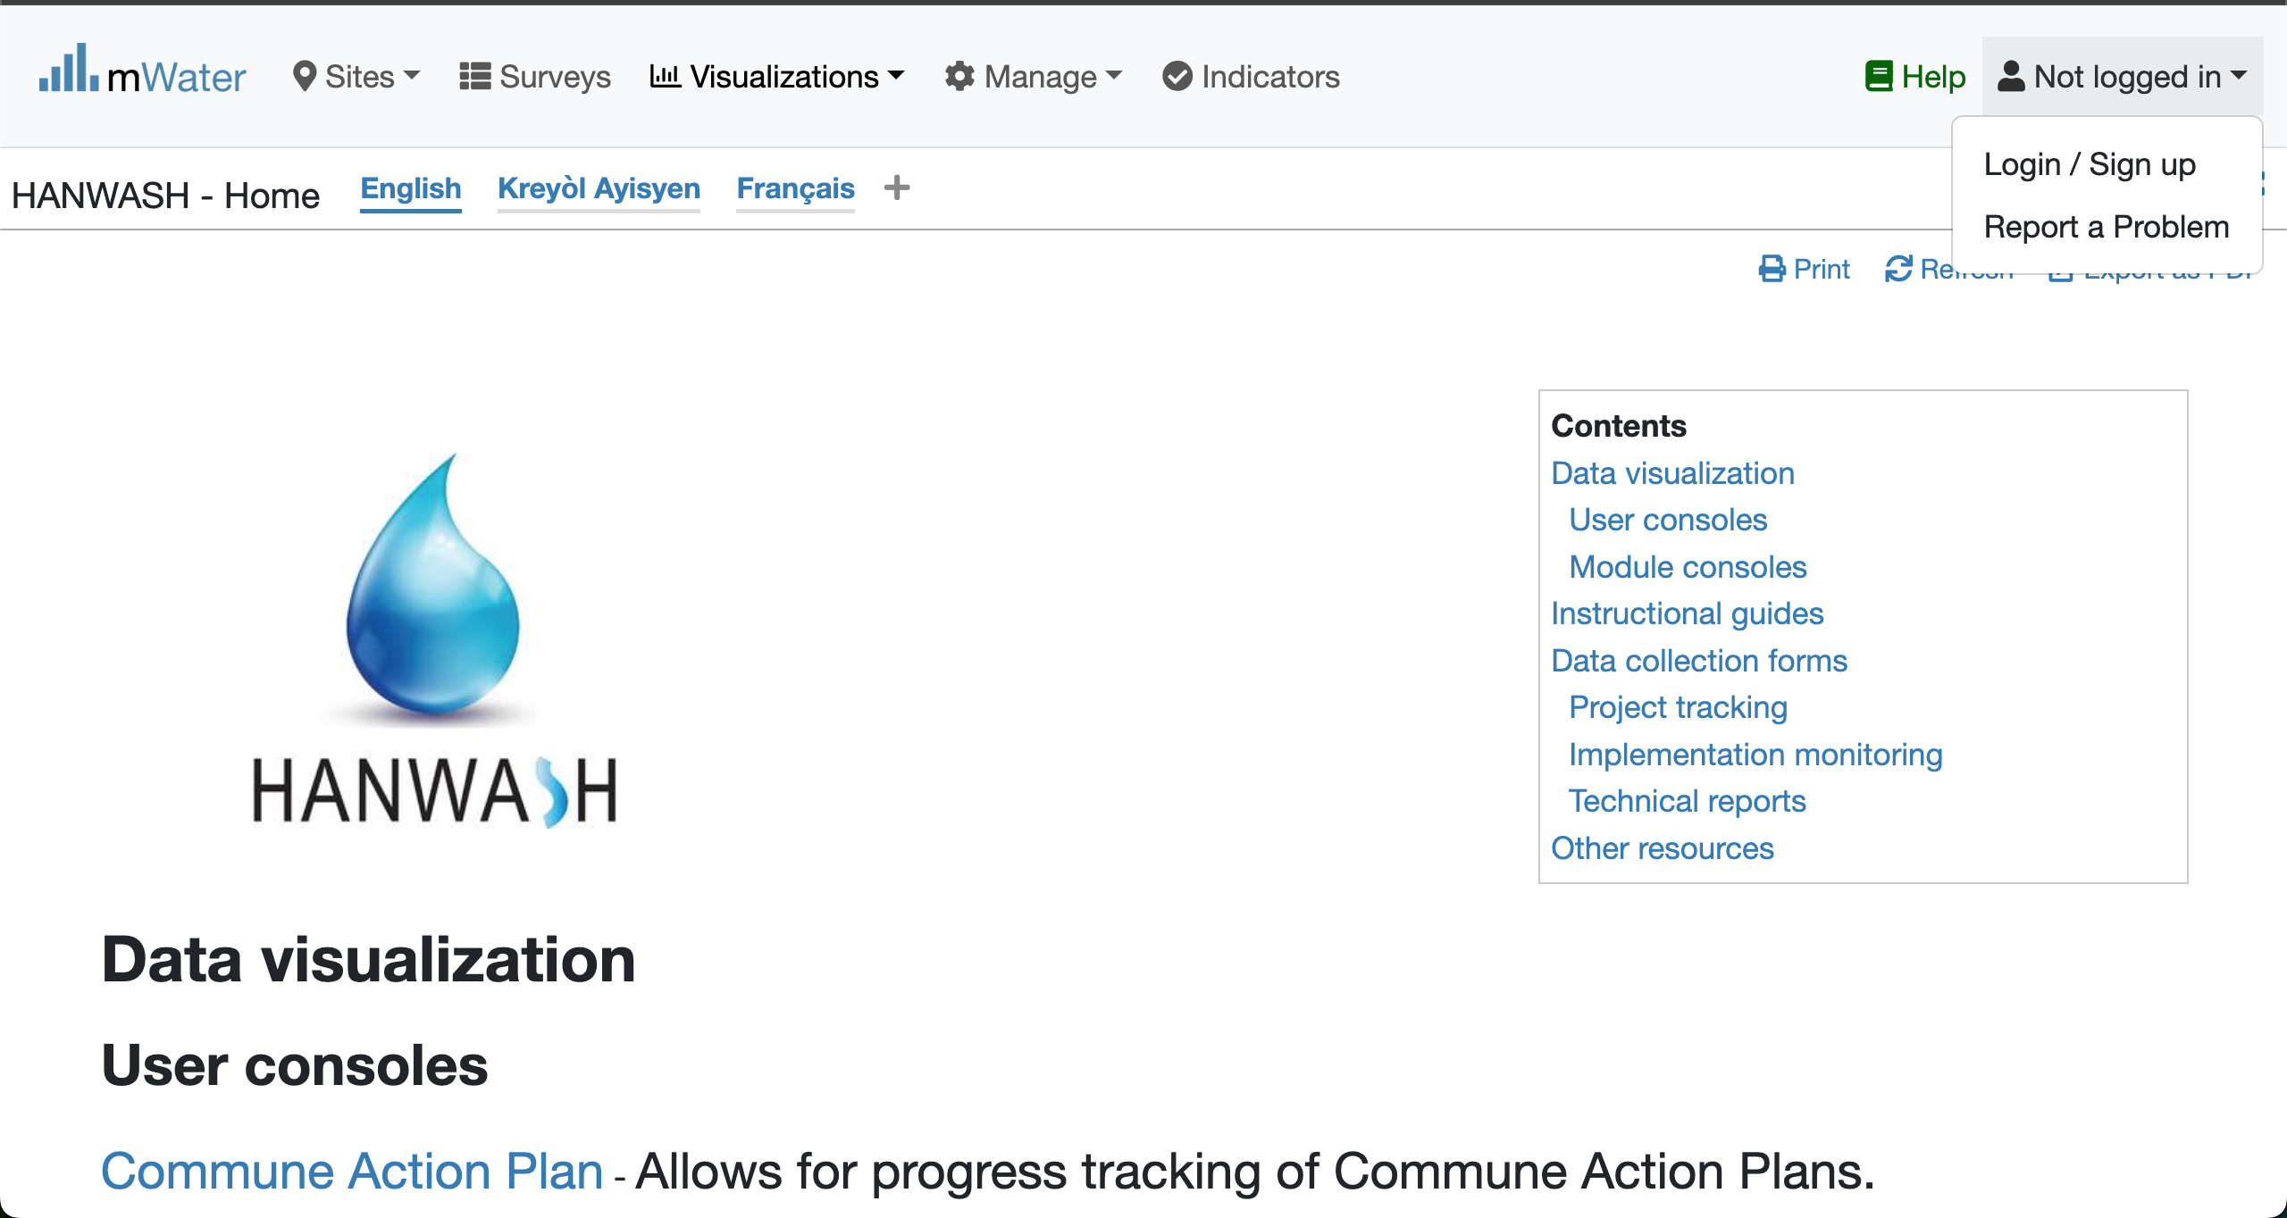


Login Process (2nd scenario)
Click to Login or Signup
Please Click on this selection box
Please enter your Credentials

Slide 6
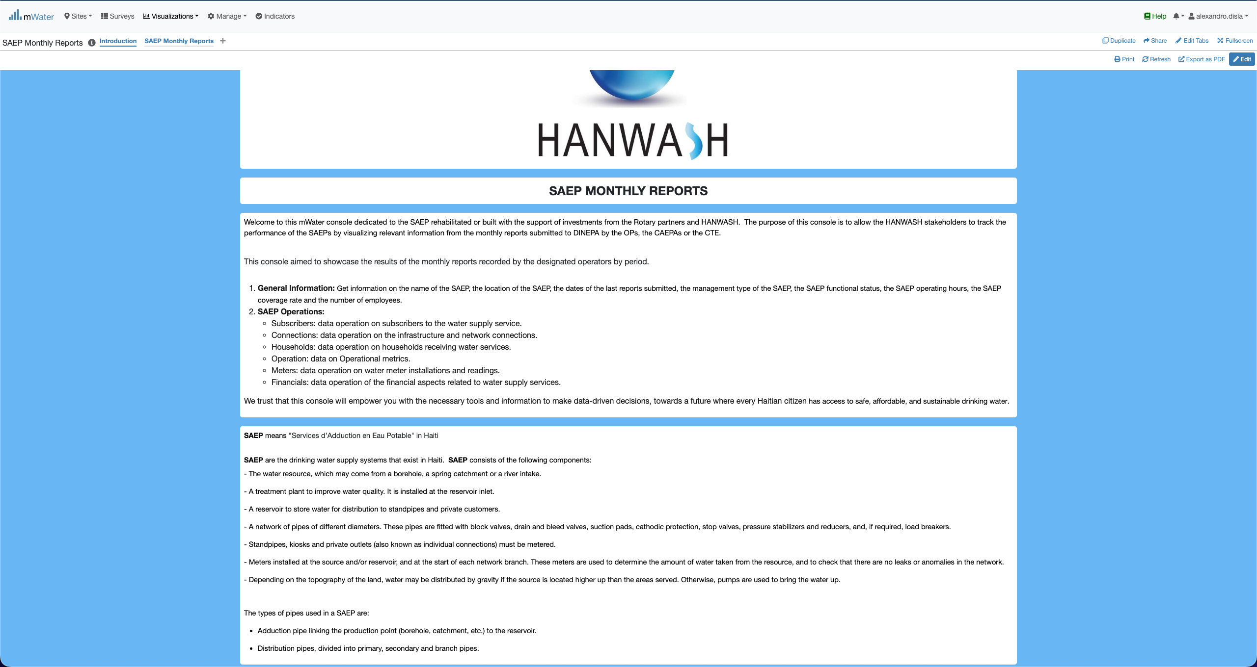
SAEP Console overview

Slide 7
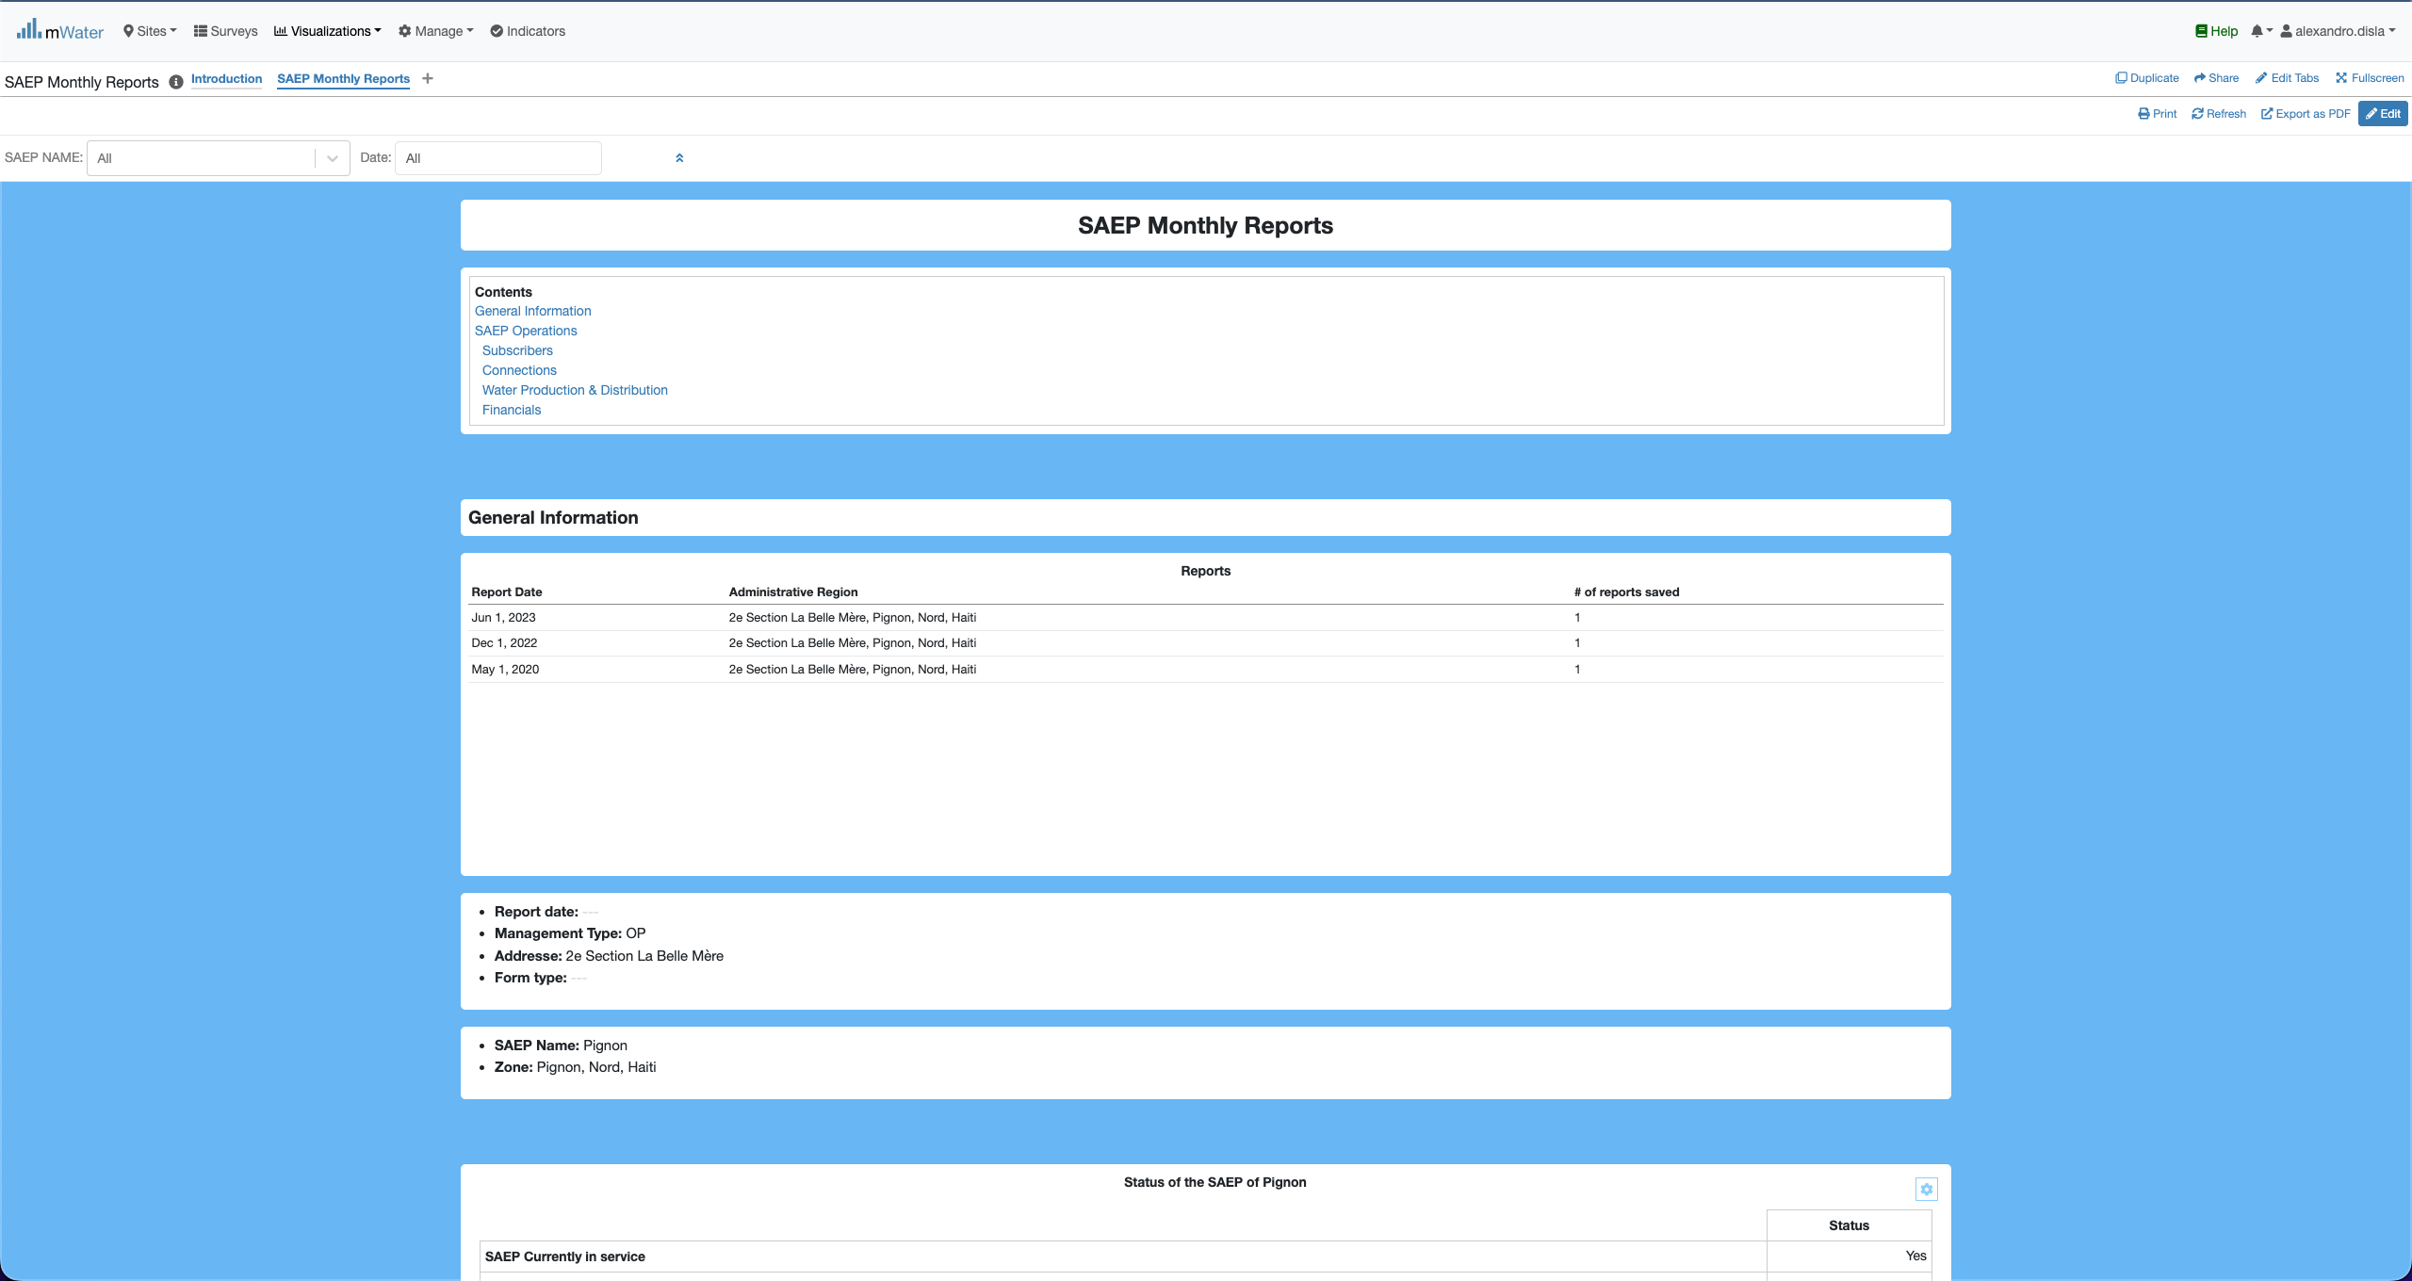
SAEP Console overview

Slide 8
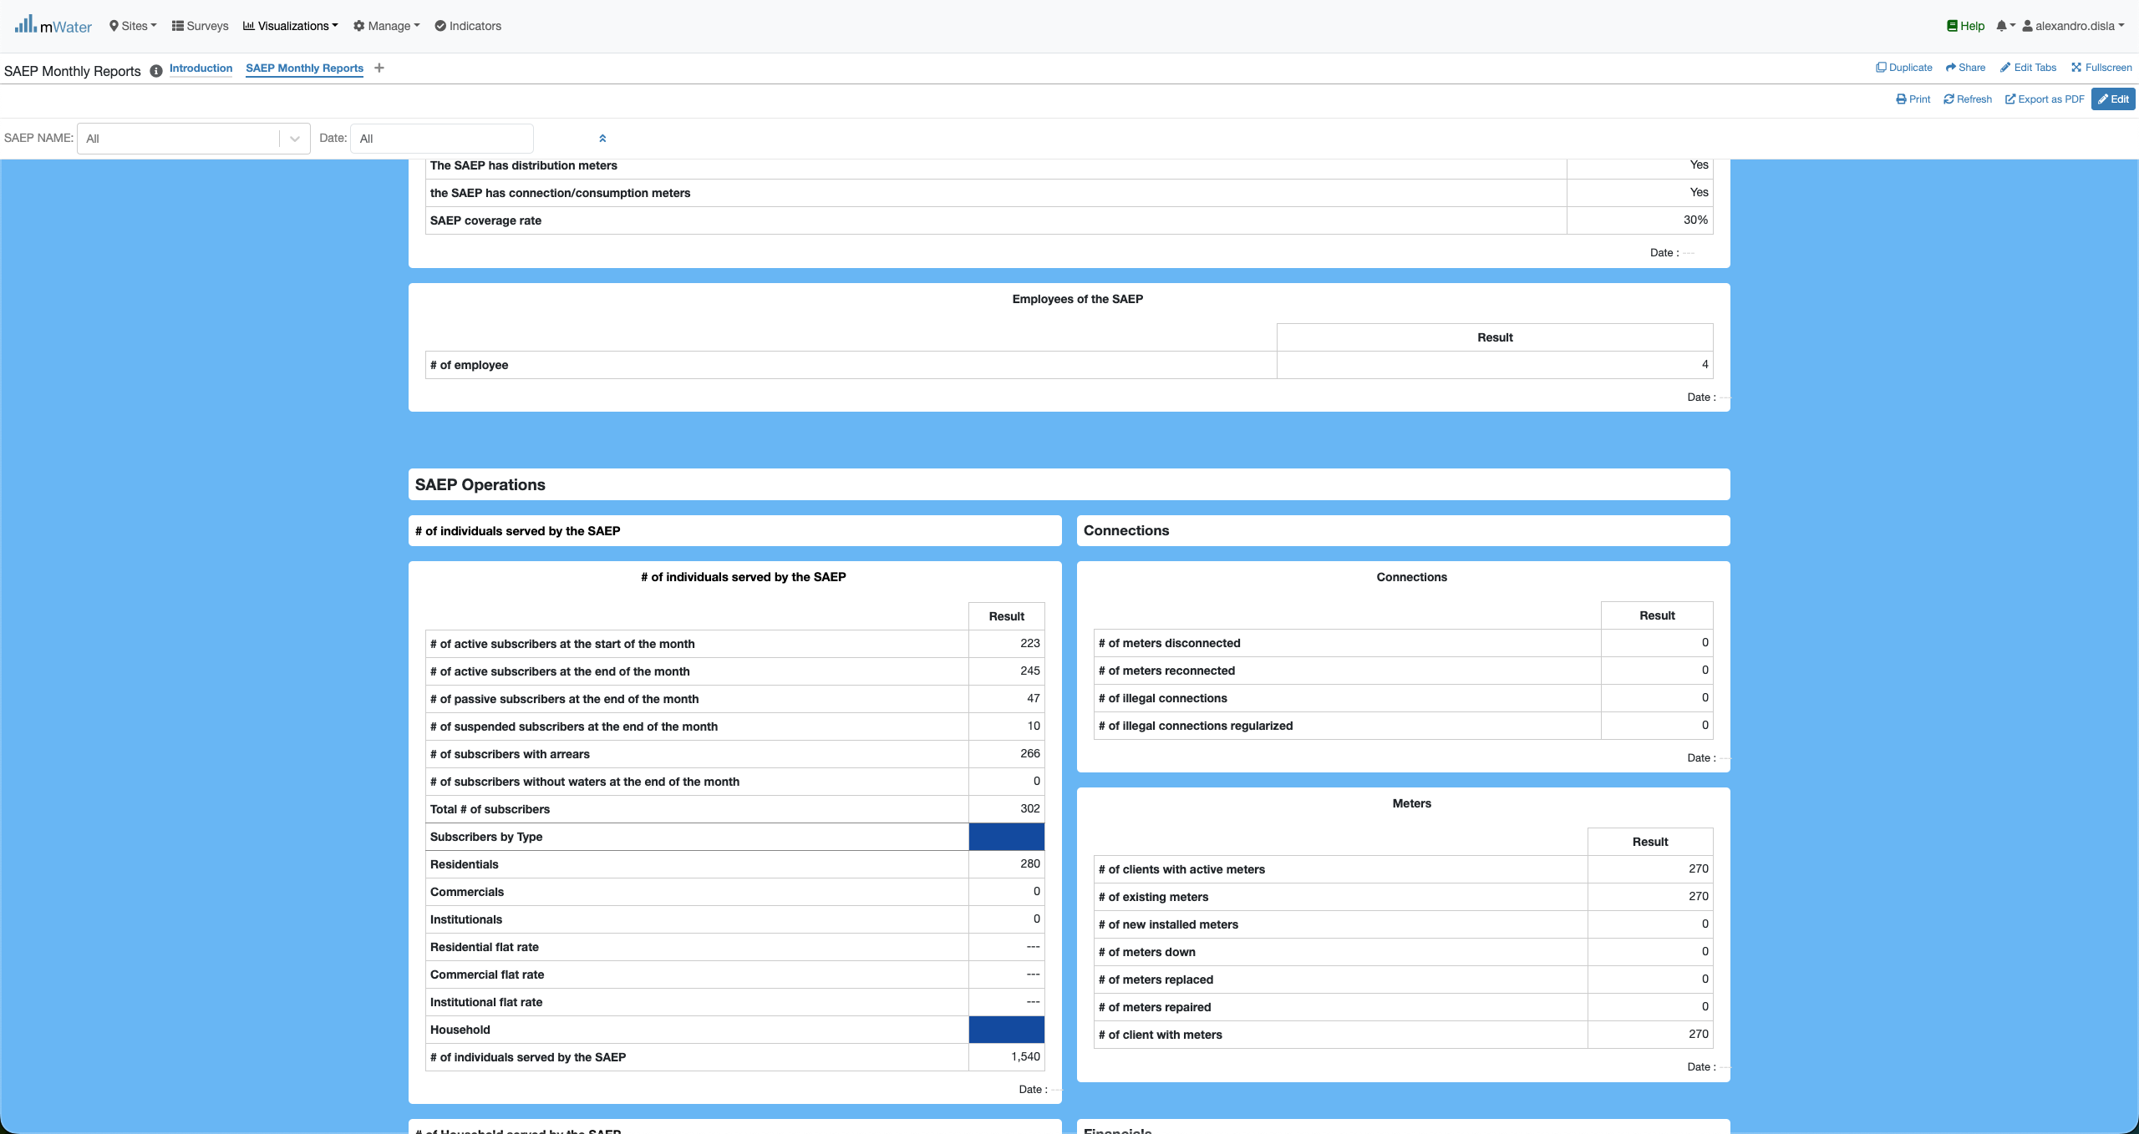
SAEP Console overview

Slide 9
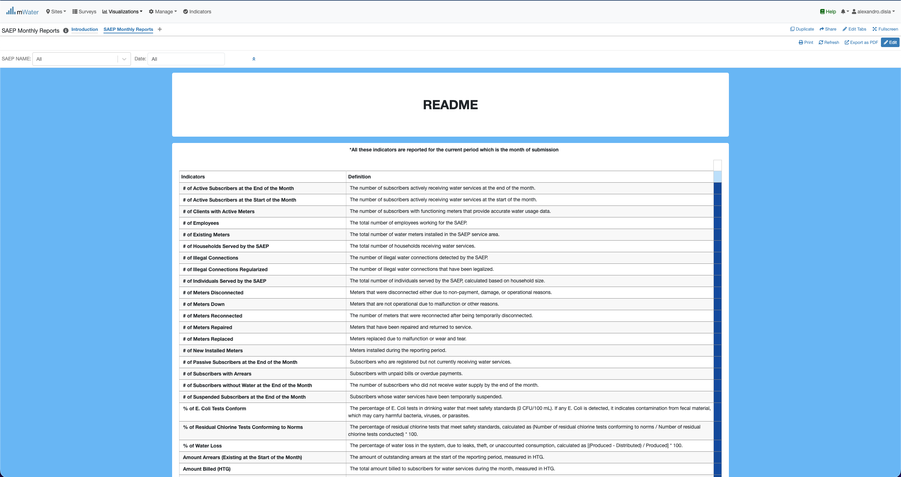
HIP Console overview

Slide 10
Functionalities
Functionalities available in the console

Slide 11
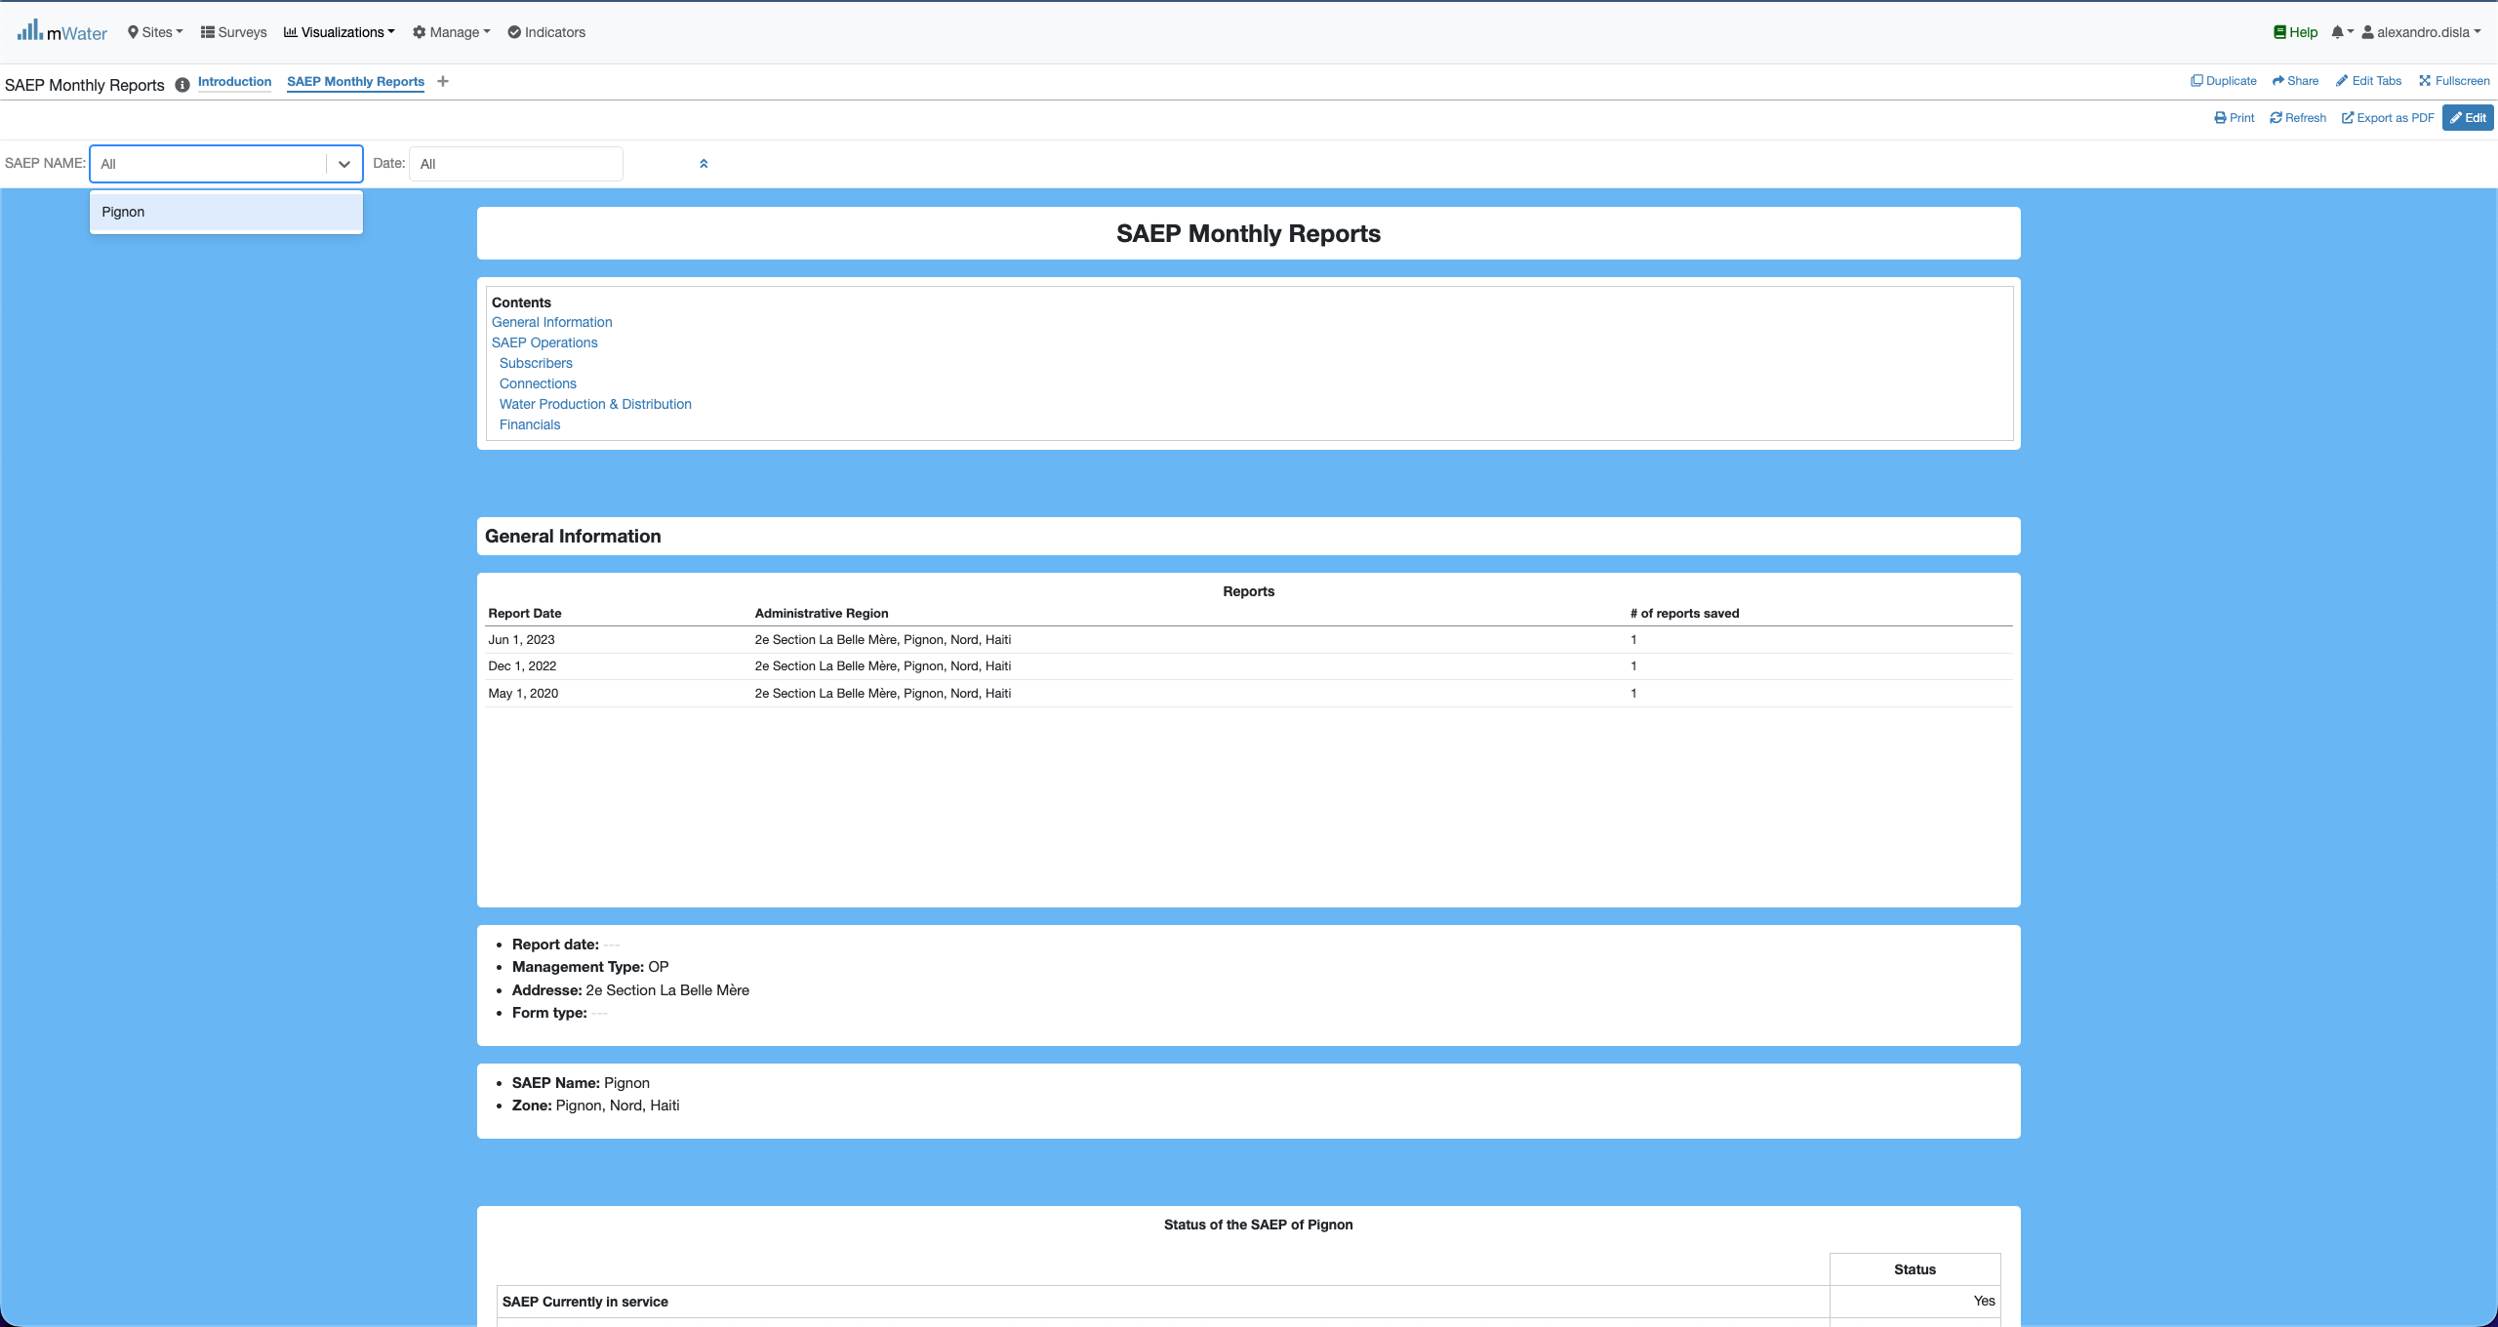
Quick filters
The SAEP Name and any future saep will be display in this dropdown list.

Slide 12
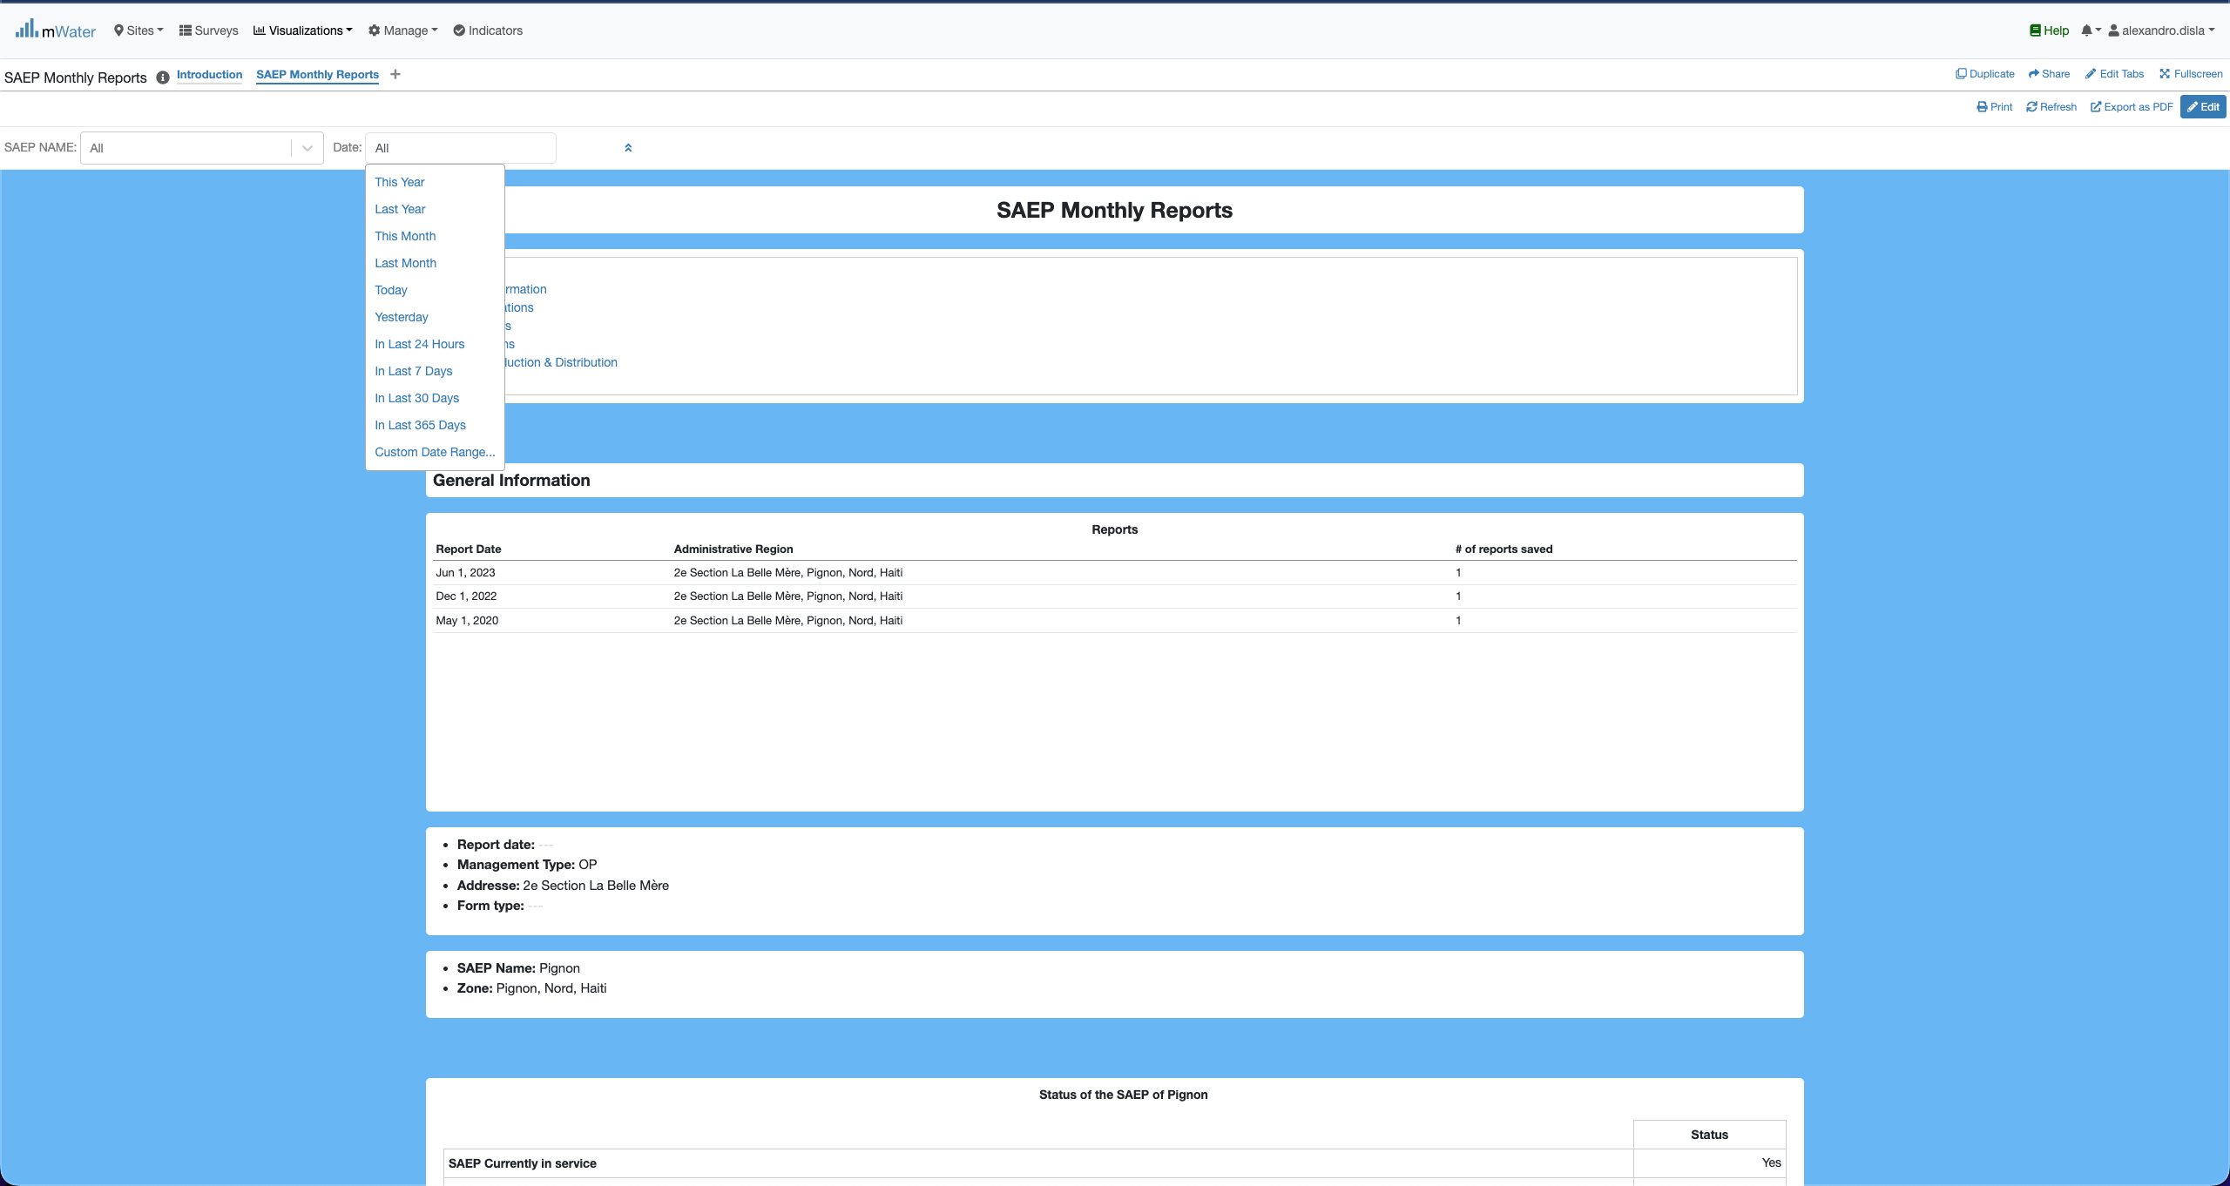
Quick filters
The Date offers us the full flexibility to work filter for a specific day or period.
This section will display all the available report for all the saep. Right now, it displays the reports for Pignon. It will help for the selection of the period.

Slide 13
How to select a report date
One of the main feature available on this Console

Slide 14
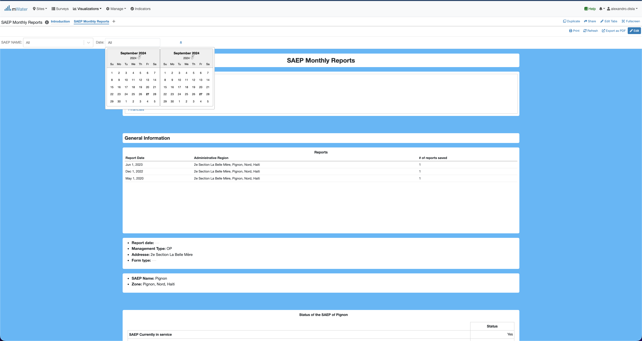
Report date
You have to have the selected in this format display lke this: 01 Jun 2023 – 01 Jun 2023
As indicated in the first table in below. We have 3 recorded reports date.

Slide 15
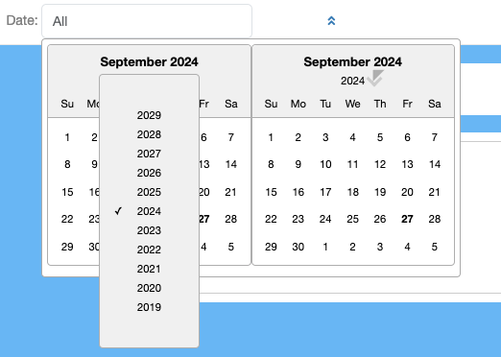
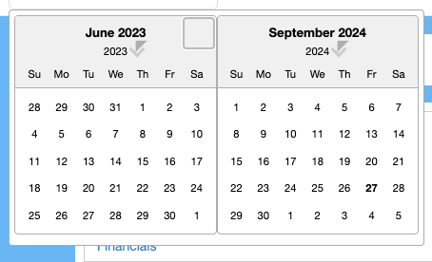
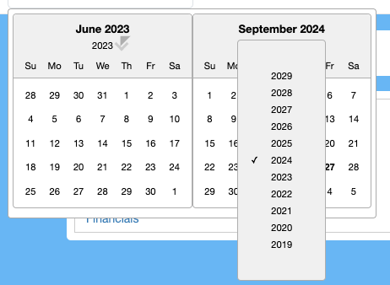
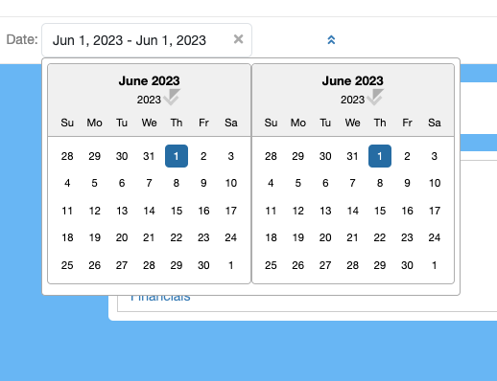
Report Date
Click on 2024, to display the month list
Click on the left or rigth side to change the months

Slide 16
Effect
Effect of The Quick Filters

Slide 17
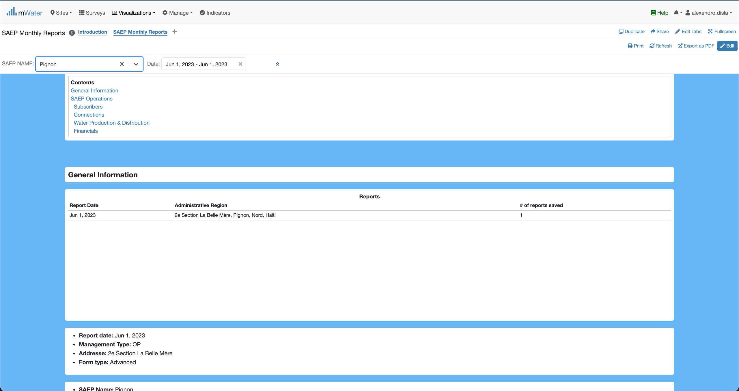
Quick Filters Selection
Now we have the date of a report selected. Plus we can add the saep name.
All the component will react to display the available results

Slide 18
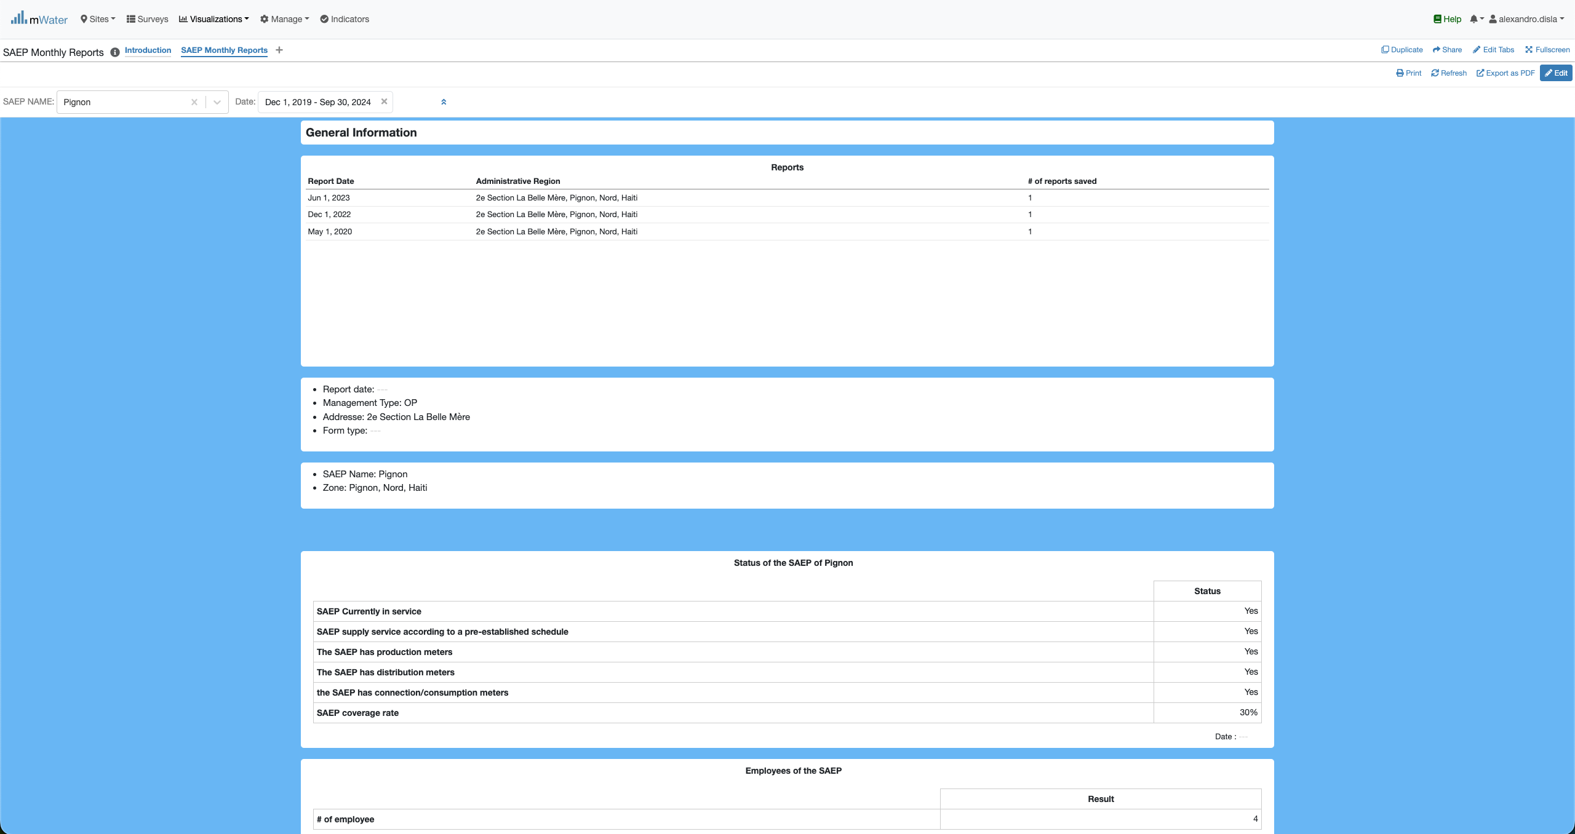
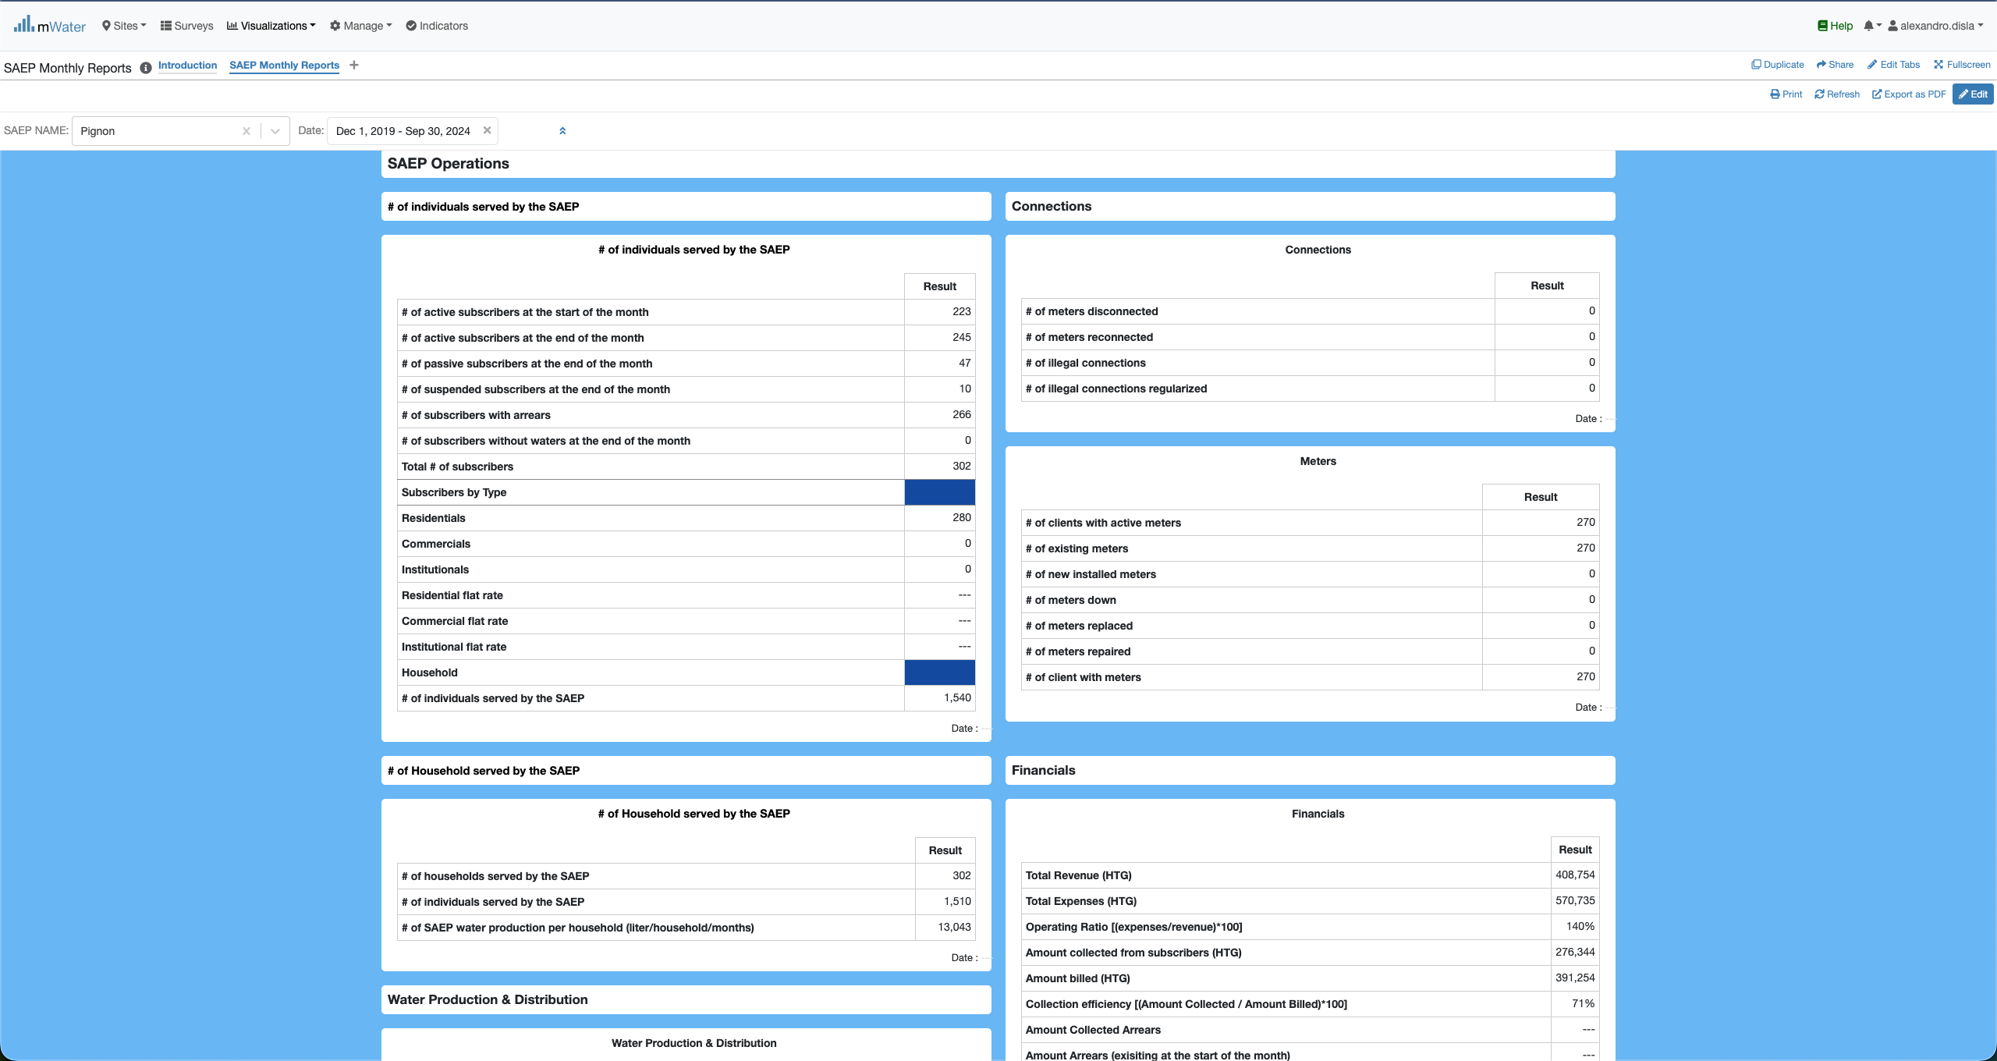
Quick Filters Selection
The General information section
The saep operation section

Slide 19
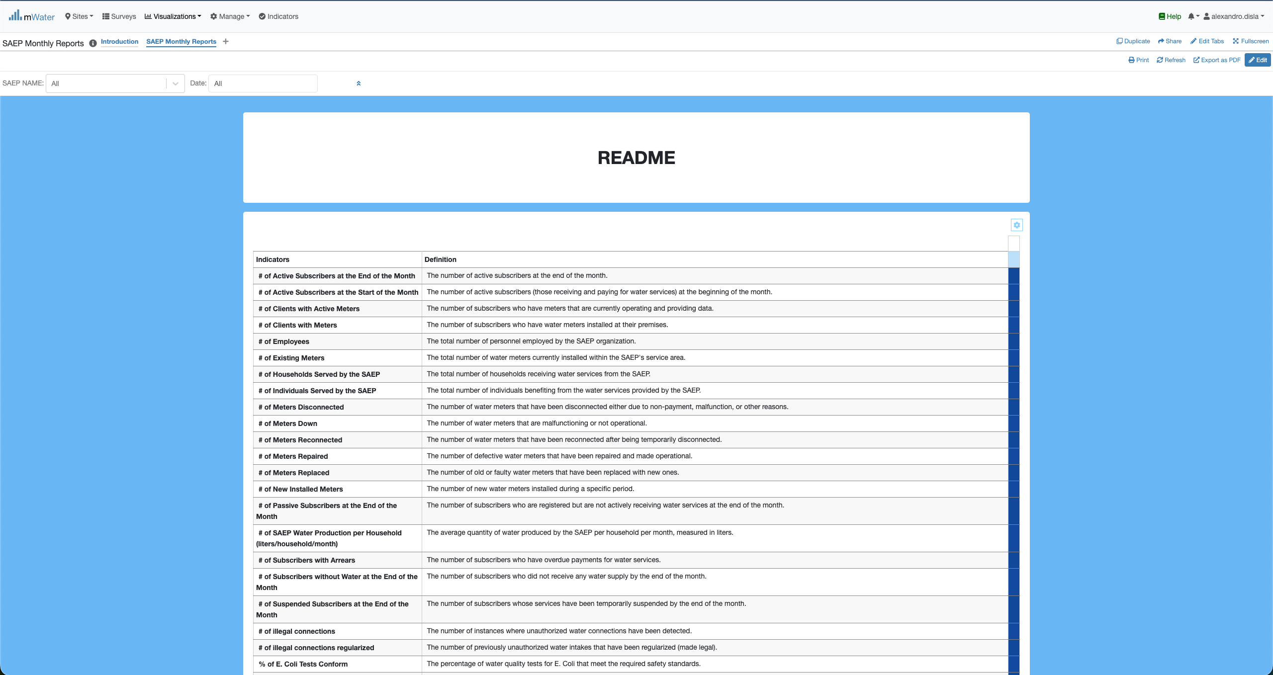
Readme section
This readme is in place to help better understand the key information displayed in the general information and operation sections.

Slide 20
Export

Slide 21
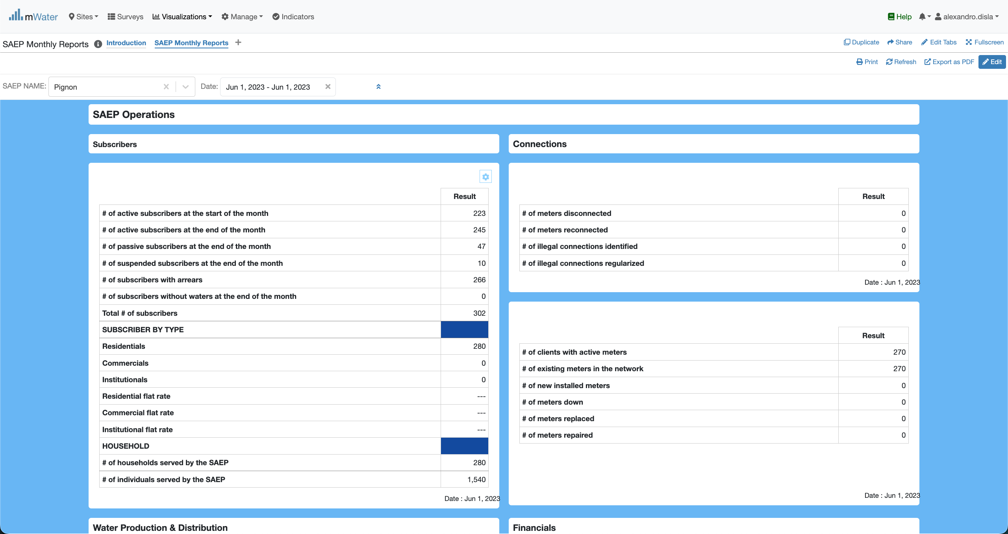
Export from the tables
Hover the cursor over one of the table of your choice. And you click on this button

Slide 22

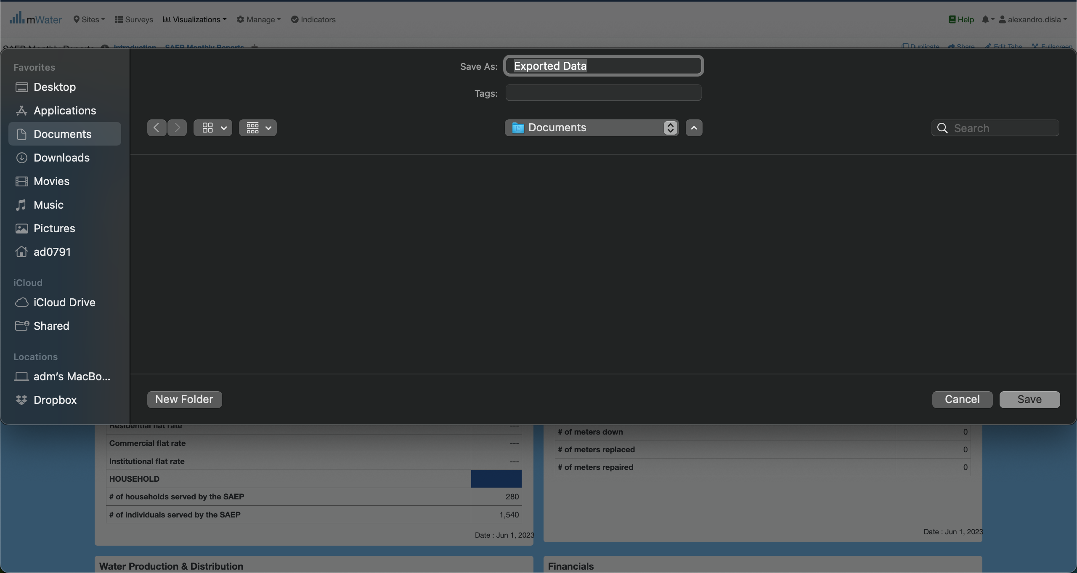
Export from the tables
This will trigger the modal with the download platform.
You can change the name of the export as well as the target location as you see fit.
Depending of your operating system, the export will be saved either on Documents or Downloads

Slide 23
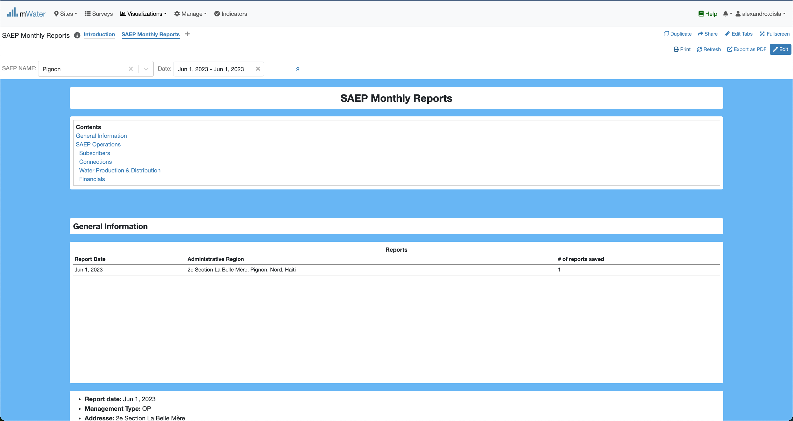
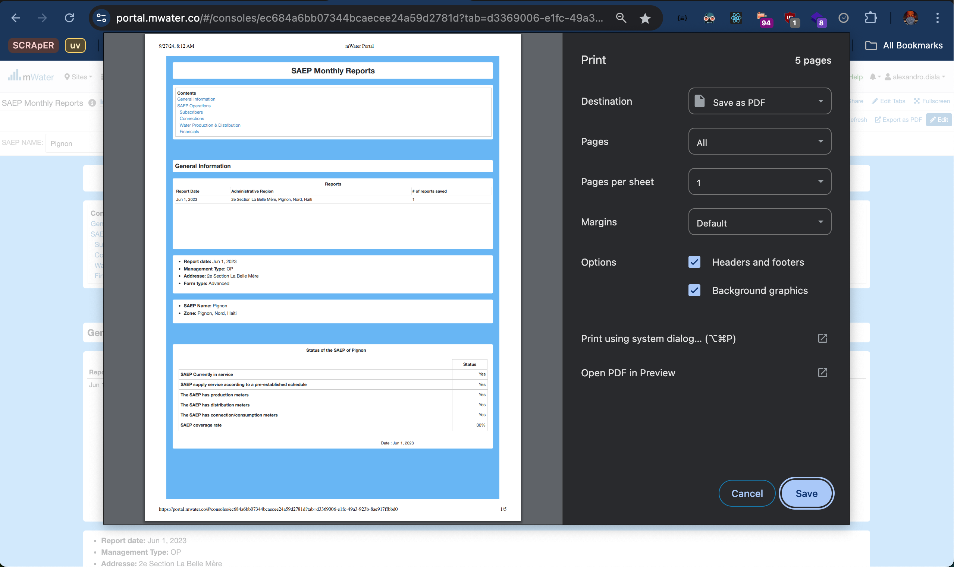
Print Export
The print Icon is another option available.
A very clear interface will help you extract the report in pdf format for your convenience.

